Slide 1
Web scraping to gain company insights
Scrape and analyse customer review data to uncover findings for British Airways

Slide 2
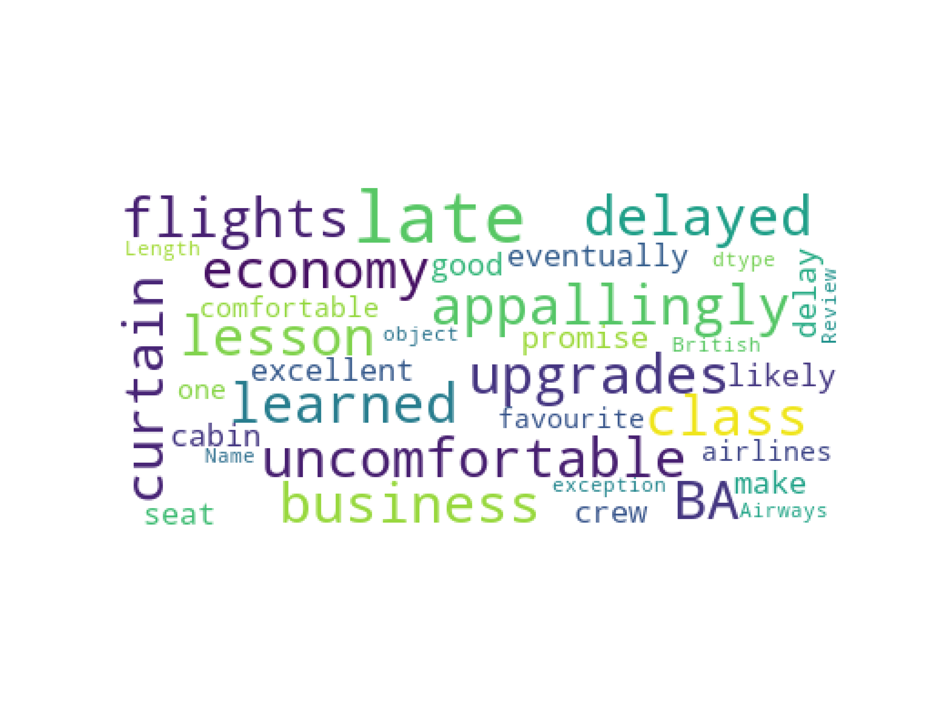
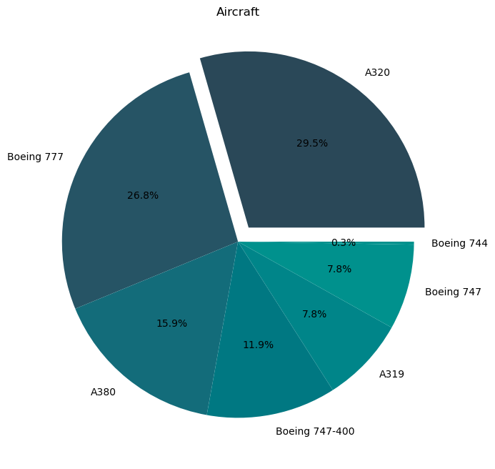
Pie Chart
Visualisation of the most used aircraft in British Airways
Word Cloud
This the word cloud that are made from customers review of British Airways at Skytrax website

